Slide 1
24/04/2024
SE IT / SEM IV
MP1B
R 19 C Scheme
Anjuman-I-Islam’s
M.H. Saboo Siddik College of Engineering
8, Saboo Siddik Polytechnic Road, Byculla – 08
DEPARTMENT OF INFORMATION TECHNOLOGY
ITM401 Mini Project – 1 B for Python based automation project review of
RESULT MANAGEMENT SYSTEM AND ANALYSIS
Under the Guidance of
Er. Tahseen Tamboli

Slide 2
TEAM MEMBERS NAME
SUTAR NAVED ROLL NO.:- 221455
ANSARI SAAD ROLL NO.:- 221458
SHAIKH ANAS ROLL NO.:- 221437

Slide 3
INTRODUCTION
It's a comprehensive solution merging result management with powerful analytical tools. Designed for educational institutions, it streamlines result handling while offering insights into student performance trends. With Python's versatility, it caters to institutions of all sizes. Simplify result management and unlock valuable insights with our system. The Result Management System with Analysis serves as a vital tool for educational institutions to efficiently manage and analyze student performance data. This report provides an overview of the functionalities, analysis capabilities, and benefits of the Result Management System with Analysis.

Slide 4
PROBLEM DEFINITION
The current manual result management processes in educational institutions are time-consuming, error-prone, and lack analytical insights. Educators struggle to efficiently handle and analyze vast amounts of student data, hindering informed decision-making. There's a need for an automated Result Management System with Analysis to streamline result handling, eliminate errors, and provide valuable insights into student performance trends, empowering educators to make data-driven decisions effectively.

Slide 5
PORPOSED SYSTEM
The Result Management System with Analysis automates result handling and integrates advanced analytical tools to enhance efficiency and insights in educational institutions. Key features include:
Result Entry: Streamlined interface for easy entry of student results, supporting various grading systems and formats.
Result Storage: Secure storage of student data with options for backup and restoration, ensuring data integrity.
Result Retrieval: Quick and efficient retrieval of student results for administrators and educators.
Analysis Tools: Powerful analytical tools to analyze performance trends, identify strengths, weaknesses, and patterns.
Customization: Flexible system allowing customization to suit the specific needs of different educational institutions.
Reporting: Generation of comprehensive reports and visualizations for in-depth analysis and presentation.
User Management: Role-based access control to manage user permissions and ensure data security.
Scalability: Designed to scale with the growth of educational institutions, accommodating increasing data volumes and user demands.

Slide 6
LITERATURE REVIEW
Sr. No. | Paper Name | Journal Name | Published Year | Comparative Analysis
1 | Web-based Student Result Management System [1] | Mohammad Gulam Lorgat | 2004 | In the development of a multi-user system, based on web technology with architectural pattern and developed using Java programming language with Apache Tomcat Server and MySQL Database Management System support.
2 | Student Performance Analysis System (SPAS) [2] | Chew Li Sa, Dayang Hanani bt.Abang Ibrahim, Emmy Dahlina Hossain | 2012 | The proposed system offers student performance prediction through the rules generated via data mining technique. The data mining technique used in the project is classification, which classifies the students based on the student’s grade.The most effective technique by analysing the results
3 | Student Information Report System with SMS (SIRS) [3] | Isbudeen Noor Mohamed, Ahmad Tasnim Sidiqui, Syed Ajaz, S Mohamed Idhris | 2016 | The proposed system is an application software and which has an intention to begin a conductive and direct interchanging the statistics in a secure platform to coalesce with students, faculties and the college/school administration. The student can check their results through an SMS sent to the student/parent’s contact numbers..

Slide 7
PROJECT MODULES
Admin Page
Homepage
Student List
Upload Student List
Result Sheet
6. Result Analysis
7. Settings
8. Check Drop
9. Logout

Slide 8
H/W & S/W Requirements
Hardware Requirements
Multi-core Processor
Minimum 4 GB RAM
SSD
Ethernet
Software Requirements
VS Code
Python (Flask)
HTML5
CSS
Windows
Database & API
MongoDB
Python (Pymongo)

Slide 9
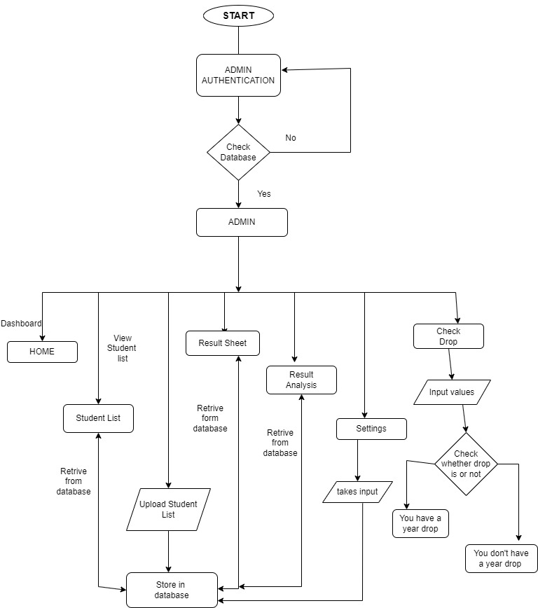
ARCHITECTURE DIAGRAM

Slide 10
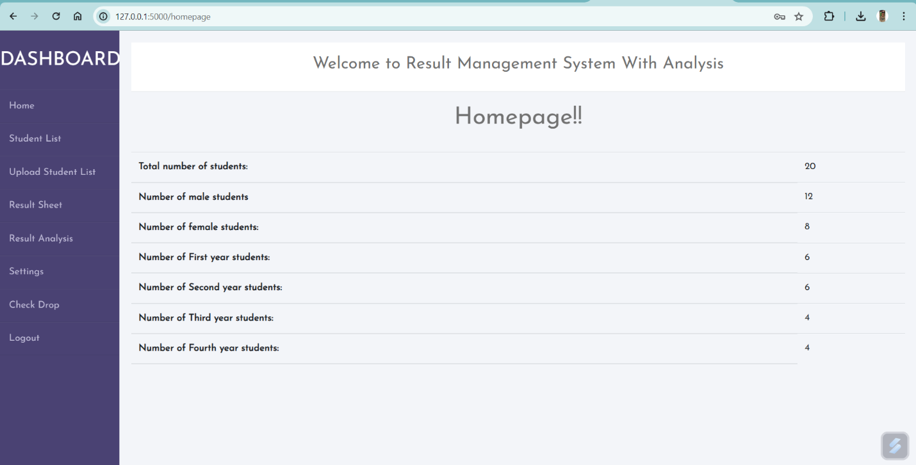
RESULT & OUTCOME

Slide 11
CONCLUSION
In conclusion, the Result Management System with Analysis project represents a significant endeavor aimed at enhancing the efficiency, effectiveness, and transparency of managing student performance data within educational institutions. Through careful design, implementation, testing, and analysis, the Result Management System with Analysis offers a robust platform that meets the diverse needs of administrators, teachers, students, and parents. The Result Management System with Analysis provides a user-friendly interface with role-based access control.

Slide 12
FUTURE SCOPE
The Result Management System with Analysis project lays a solid foundation for managing student performance data within educational institutions. However, there are several avenues for future expansion and enhancement to further improve its functionality, usability, and impact. Here are some potential future scopes for the Result Management System with Analysis project:
Advanced Analytics and Insights:
Incorporate advanced data analytics techniques such as predictive modeling and machine learning to provide insights into student performance trends, identify at-risk students, and recommend personalized interventions.
Implement predictive analytics algorithms to forecast student grades and anticipate academic challenges, allowing educators to proactively address student needs.
Enhanced Communication and Collaboration:
Integrate features for seamless communication and collaboration between teachers, students, parents, and administrators within the Result Management System with Analysis platform.
Implement real-time messaging, discussion forums, and notification systems to facilitate communication about assignments, assessments, and academic progress

Slide 13
REFERENCES
[1] www.mongodb.com/docs/ accessed on 01/03/2024 by Dwight Merriman, Eliot Horowitz and Kevin Ryan
[2] www.flask.palletsprojects.com/en/3.0.x/ released 17/14/2007 by Armin Ronacher of Pocoo
[3] www.w3schools.com/html/html_intro.asp accessed on 03/03/2024.
[4] www.w3schools.com/cssref/index.php released on 17/12/1996

Slide 14
REFERENCES
THANK YOU !

